Slide 1

UNIT I
FINITE AUTOMATA

Slide 2
UNIT-I SYLLABUS
FINITE AUTOMATA : The Equivalence of Deterministic and Non-deterministic Finite Automata, Definition and Description of a Finite Automaton, Deterministic and Non-deterministic Finite State Machines, Acceptability of a String by a Finite Automaton, Mealy and Moore Machines, Minimization of Finite Automata, Basics of Strings and Alphabets, Transition Graph and Properties of Transition Functions, Regular Languages

Slide 3
Automation
An automaton is defined as a system where energy, materials and information are transformed, transmitted and used for performing some functions without direct participation of man.
Examples are automatic machine tools, automatic packing machines, and automatic photo printing machines.

Slide 4
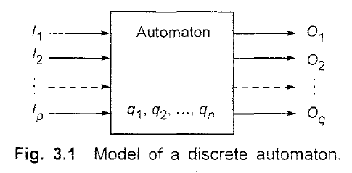
Automation
In computer science the term 'automaton' means 'discrete automaton' and is defined in a more abstract way as shown in Fig.

Slide 5
Automation
The characteristics of automaton are now described.
(i) Input. At each of the discrete instants of time t1, t2, ... tm the input values I1, I2,…Ip, each of which can take a finite number of fixed values from the input alphabet Σ, are applied to the input side of the model.
ii) Output. 01, O2, ..., Oq are the outputs of the model, each of which can take a finite number of fixed values from an output O.
(iii) States. At any instant of time the automaton can be in one of the states q1 q2, ..., qn'
(iv) State relation. The next state of an automaton at any instant of time is determined by the present state and the present input.
(v) Output relation. The output is related to either state only or to both the input and the state. It should be noted that at any instant of time the automaton is in some state. On 'reading' an input symbol, the automaton moves to a next state which is given by the state relation.

Slide 6
Note
An automaton in which the output depends only on the input is called an automaton without a memory.
An automaton in which the output depends on the states as well is called automaton with a finite memory.

Slide 7
Alphabet
An alphabet is a finite, non-empty set of symbols
We use the symbol ∑ (sigma) to denote an alphabet
Examples:
  Binary: ∑ = {0,1}
  All lower case letters: ∑ = {a,b,c,..z}
  Alphanumeric: ∑ = {a-z, A-Z, 0-9}
  DNA molecule letters: ∑ = {a,c,g,t}
  …
Notes:
Cpt S 317: Spring 2009
School of EECS, WSU

Slide 8
Strings
A string or word is a finite sequence of symbols chosen from ∑
Empty string is ε (or “epsilon”)
Length of a string w, denoted by “|w|”, is equal to the number of (non- ε) characters in the string
  E.g., x = 010100 |x| = 6
  x = 01 ε 0 ε 1 ε 00 ε |x| = ?
  xy = concatentation of two strings x and y
Notes:
Cpt S 317: Spring 2009
School of EECS, WSU

Slide 9
Powers of an alphabet
  Let ∑ be an alphabet.
  ∑^{k} = the set of all strings of length k
  ∑* = ∑⁰ U ∑¹ U ∑² U …
  ∑⁺ = ∑¹ U ∑² U ∑³ U …
Notes:
Cpt S 317: Spring 2009
School of EECS, WSU

Slide 10
Languages
L is a said to be a language over alphabet ∑, only if L ⊆ ∑*
  ➔ this is because ∑* is the set of all strings (of all possible length including 0) over the given alphabet ∑
Examples:
  Let L be the language of all strings consisting of n 0’s followed by n 1’s:
  L = {ε, 01, 0011, 000111,…}
  Let L be the language of all strings of with equal number of 0’s and 1’s:
  L = {ε, 01, 10, 0011, 1100, 0101, 1010, 1001,…}
Definition: Ø denotes the Empty language
Let L = {ε}; Is L=Ø?
Canonical ordering of strings in the language
NO
Notes:
Cpt S 317: Spring 2009
School of EECS, WSU

Slide 11
The Membership Problem
Given a string w ∈∑*and a language L over ∑, decide whether or not w ∈L.
Example:
Let w = 100011
Q) Is w ∈ the language of strings with equal number of 0s and 1s?
Notes:
Cpt S 317: Spring 2009
School of EECS, WSU

Slide 12
Finite Automata
Some Applications
  Software for designing and checking the behavior of digital circuits
  Lexical analyzer of a typical compiler
  Software for scanning large bodies of text (e.g., web pages) for pattern finding
  Software for verifying systems of all types that have a finite number of states (e.g., stock market transaction, communication/network protocol)
Notes:
Cpt S 317: Spring 2009
School of EECS, WSU

Slide 13
Finite Automata
Finite automata are used to recognize patterns.
It takes the string of symbol as input and changes its state accordingly. When the desired symbol is found, then the transition occurs.
At the time of transition, the automata can either move to the next state or stay in the same state.
Finite automata have two states, Accept state or Reject state. When the input string is processed successfully, and the automata reached its final state, then it will accept.

Slide 14
Formal Definition of FA
A finite automaton is a collection of 5-tuple (Q, ∑, δ, q0, F), where:
Q: finite nonempty set of states
∑: finite nonempty set of the input symbol
q0: q0 ∈ Q is the initial state
F: F ⊆ Q is the final state
δ: is a Transition function which maps Q x ∑ into Q and is usually called the direct transition function. This is the function which describes the change of states during the transition. This mapping is usually represented by a transition table or a transition diagram

Slide 15
Note
The transition function which maps Q x Σ* into Q (i.e. maps a state and a string of input symbols including the empty string into a state) is called the indirect transition function. We shall use the same symbol δ to represent both types of transition functions and the difference can be easily identified by the nature of mapping (symbol or a string), i.e. by the argument. δ is also called the next state function.

Slide 16
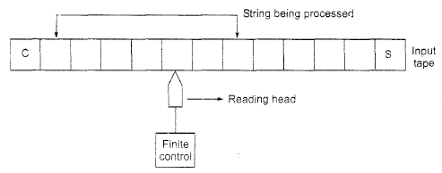
Block diagram of a FA
(i) Input tape. The input tape is divided into squares, each square containing a single symbol from the input alphabet L. The end squares of the tape contain the endmarker ¢ at the left end and the endmarker $ at the right end. The absence of endmarkers indicates that the tape is of infinite length. The left-to-right sequence of symbols between the two endmarkers is the input string to be processed.
(ii) Reading head. The head examines only one square at a time and can move one square either to the left or to the right. For further analysis, we restrict the movement of the R-head only to the right side.
(iii) Finite control. The input to the finite control will usually be the symbol under the R-head, say a, and the present state of the machine, say q, to give the following outputs: (a) A motion of R-head along the tape to the next square (in some a null move, i.e. the R-head remaining to the same square is permitted); (b) the next state of the finite state machine given by b(q, a).

Slide 17
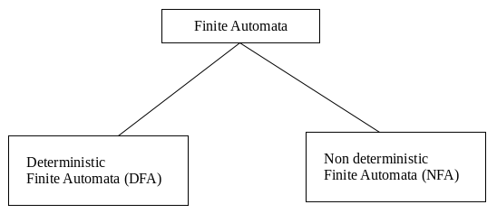
Types of Automata
There are two types of finite automata:
1. DFA(deterministic finite automata)
2. NFA(non-deterministic finite automata)

Slide 18
Deterministic Finite Automata(DFA)
The finite automata are called deterministic finite automata if the m/c is read an i/p string one symbol at a time.
Deterministic refers to the uniqueness of the computation.
In the DFA, there is only one path for specific i/p from the current state to the next state.
DFA does not accept the null move i.e. DFA cannot change state without any i/p character.
DFA can contain multiple final states.

Slide 19
Formal Definition of DFA
A DFA can be represented by a 5-tuple (Q, ∑, δ, q₀, F) where −
Q is a finite set of states.
∑ is a finite set of symbols called the alphabet.
δ is the transition function where δ: Q × ∑ → Q
q₀ is the initial state from where any input is processed (q₀ ∈ Q).
F is a set of final state/states of Q (F ⊆ Q).

Slide 20
Graphical Representation of a DFA
A DFA is represented by digraphs called state diagram.
The vertices represent the states.
The arcs labeled with an input alphabet show the transitions.
The initial state is denoted by an empty single incoming arc.
The final state is indicated by double circles.

Slide 21
Example
Let a deterministic finite automaton be →
Q = {a, b, c},
∑ = {0, 1},
q₀ = {a},
F = {c}, and

Slide 22
No of States = | Min String |+1

Slide 23
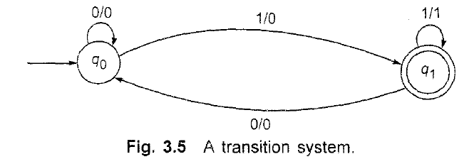
TRANSITION SYSTEMS
A transition graph or a transition system is a finite directed labelled graph in which each vertex (or node) represents a state and the directed edges indicate the transition of a state and the edges are labelled with input output.

Slide 24
TRANSITION SYSTEMS
Definition 3.2 A transition system is a 5-tuple (Q, ∑, δ, Qo, F), where
(i) Q. ∑ and F are the finite nonempty set of states, the input alphabet, and the set of final states, respectively, as in the case of finite automata;
(ii) Qo ⊆ Q. and Qo is nonempty: and
(iii) δ is a finite subset of Q x ∑ * x Q.
In other words, if (q1, w, q2) is in δ. it means that the graph starts at the vertex q1, goes along a set of edges, and reaches the vertex q2' The concatenation of the label of all the edges thus encountered is w.
Definition 3.3 .A transition system accepts a string w in ∑ * if
(i) there exists a path which originates from some initial state, goes along the arrows, and terminates at some final state; and
(ii) the path value obtained by concatenation of all edge-labels of the path is equal to w.

Slide 25
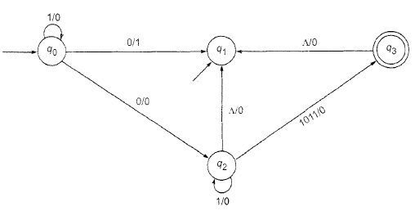
Determine the initial states, the final states, and the acceptability of 101011, 111010.
Solution
The initial states are qo and q1. There is only one final state, namely q3
The path-value of q0q0q2q3 is 101011. As q3 is the final state, 101011 is accepted by the transition system. But. 111010 is not accepted by the transition system as there is no path with path value 111010.

Slide 26
Properties of Transition Functions
Property 1 δ {Q, Λ) =q is a finite automaton. This means that the state of the system can be changed only by an input symbol.
Property 2 For all stlings wand input symbols a,
δ(q, aw)= δ(δ(q, a), w)
δ(q, wa) = δ(δ(q, w), a)

Slide 27
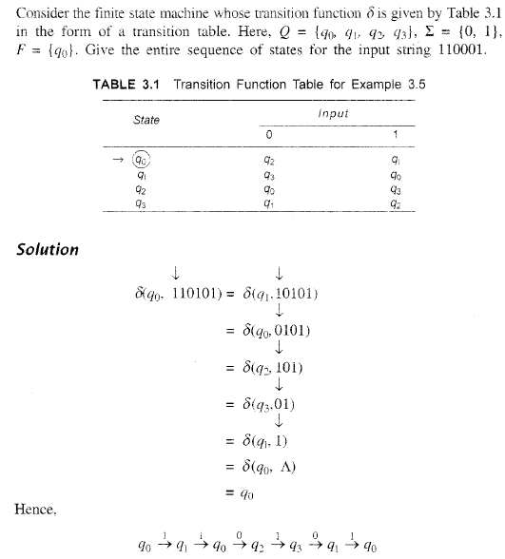


Slide 28
Practice Questions on DFA
Acceptance of languages: Reaching to final state
DFA to accept zero or more “a”
L={a,aa,aaa, aaaa,………..}

Slide 29
1.Construct DFA accepting all strings over {a,b} ending with ‘ab’
2.Construct DFA accepting all strings over {a,b} ending with ‘abb’

Slide 30
Non Deterministic Finite Automata(NDFA)
The FA are called NFA, when there exist many paths for specific i/p from the current state to the next state.
It is easy to construct NFA than DFA for a given regular language.
Every NFA is not DFA, but each NFA can be translated into DFA.

Slide 31
NFA is defined in the same way as DFA but with two exceptions:
1. It contain multiple next state
2. It contains ∈ transitions.

Slide 32
Formal Definition of an NDFA
An NDFA can be represented by a 5-tuple (Q, ∑, δ, q₀, F) where −
Q is a finite set of states.
∑ is a finite set of symbols called the alphabets.
δ is the transition function where δ: Q × ∑ → 2^{Q}
(Here the power set of Q (2^{Q}) has been taken because in case of NDFA, from a state, transition can occur to any combination of Q states)
q₀ is the initial state from where any input is processed (q₀ ∈ Q).
F is a set of final state/states of Q (F ⊆ Q).

Slide 33
Graphical Representation of an NDFA: (same as DFA)
An NDFA is represented by digraphs called state diagram.
The vertices represent the states.
The arcs labeled with an input alphabet show the transitions.
The initial state is denoted by an empty single incoming arc.
The final state is indicated by double circles.

Slide 34
Example
Let a non-deterministic finite automaton be →
Q = {a, b, c}
∑ = {0, 1}
q₀ = {a}
F = {c}

Slide 35
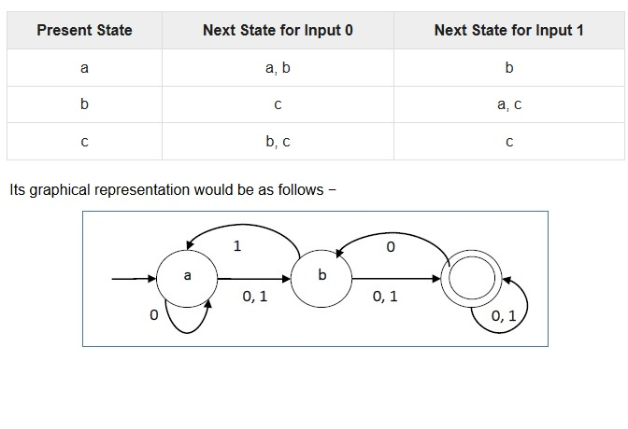

Slide 36
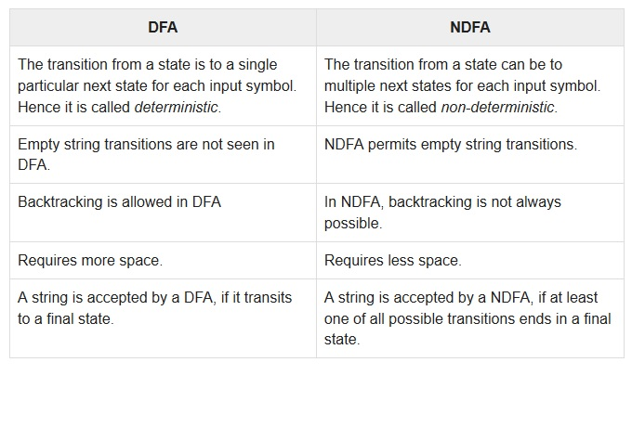
DFA vs NDFA

Slide 37
Practice Questions on NFA

Slide 38
Question 1: Design NFA for given transition table.
State | 0 | 1
-> q0 | q0, q1 | q0, q2
q1 | q3 | ∈
q2 | q2, q3 | q3
* q3 | q3 | q3

Slide 39
Question 2: Construct NFA , L={Set of all strings that starts with 0} with ∑ = {0, 1}.
Question 3: Construct NFA with ∑ = {0, 1} that accepts all string with 01.
Question 4: Construct NFA with ∑ = {0, 1} that accepts all string of length atleast 2.
Question 5: Design an NFA with ∑ = {0, 1} that accepts all strings ending with 01.

Slide 40
Question 6: Construct NFA with ∑ = {0, 1} in which double ‘1’ is followed by double ‘0’.
Question 7: Construct NFA in which all the string contain a substring 1110.
Question 8: Design an NFA with ∑ = {0, 1} that accepts all string in which the third symbol from the right end is always 0.

Slide 41
Equivalence of DFA and NFA:
Conversion from NFA to DFA
In NFA, when a specific input is given to the current state, the machine goes to multiple states.
It can have zero, one or more than one move on a given input symbol.

Slide 42
On the other hand, in DFA, when a specific input is given to the current state, the machine goes to only one state.
DFA has only one move on a given input symbol.

Slide 43
Let, M = (Q, ∑, δ, q0, F) is an NFA which accepts the language L(M).
There should be equivalent DFA denoted by M' = (Q', ∑', q0', δ', F') such that L(M) = L(M').

Slide 44
Steps for converting NFA to DFA:
Step 1: Initially Q' = ϕ
Step 2: Add q0 of NFA to Q'. Then find the transitions from this start state.
Step 3: In Q', find the possible set of states for each input symbol. If this set of states is not in Q', then add it to Q'.
Step 4: In DFA, the final state will be all the states which contain F(final states of NFA)

Slide 45
Finite automata:
Mealy and Moore Machines
Finite automata may have outputs corresponding to each transition.
There are two types of finite state machines that generate output −
Mealy Machine
Moore machine

Slide 46
Mealy Machine
A Mealy Machine is an FSM whose output depends on the present state as well as the present input.
It can be described by a 6 tuple (Q, ∑, O, δ, X, q₀) where −
Q is a finite set of states.
∑ is a finite set of symbols called the input alphabet.
O is a finite set of symbols called the output alphabet.
δ is the input transition function where δ: Q × ∑ → Q
X is the output transition function where X: Q × ∑ → O
q₀ is the initial state from where any input is processed (q₀ ∈ Q).

Slide 47
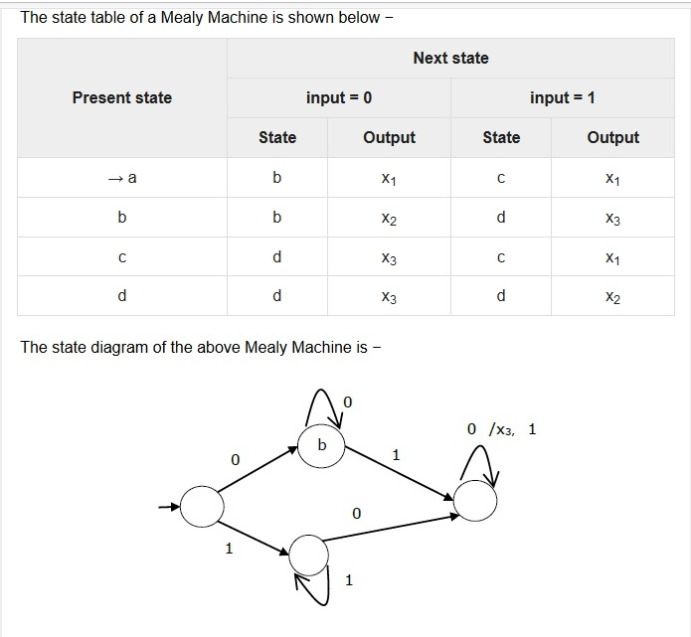
Example

Slide 48
Practice Questions
1. Construct Mealy m/c that produce 1’s complement of any binary i/p string.
2. Construct a mealy m/c that points ‘a’ whenever the sequence ‘01’ is encountered in any i/p binary string.
3. Construct a mealy m/c accepting language consisting of strings where {a,b} and the string should end with either aa or bb.

Slide 49
Moore Machine
Moore machine is an FSM whose outputs depend on only the present state.
A Moore machine can be described by a 6 tuple (Q, ∑, O, δ, X, q₀) where −
Q is a finite set of states.
∑ is a finite set of symbols called the input alphabet.
O is a finite set of symbols called the output alphabet.
δ is the input transition function where δ: Q × ∑ → Q
X is the output transition function where X: Q → O
q₀ is the initial state from where any input is processed (q₀ ∈ Q).

Slide 50
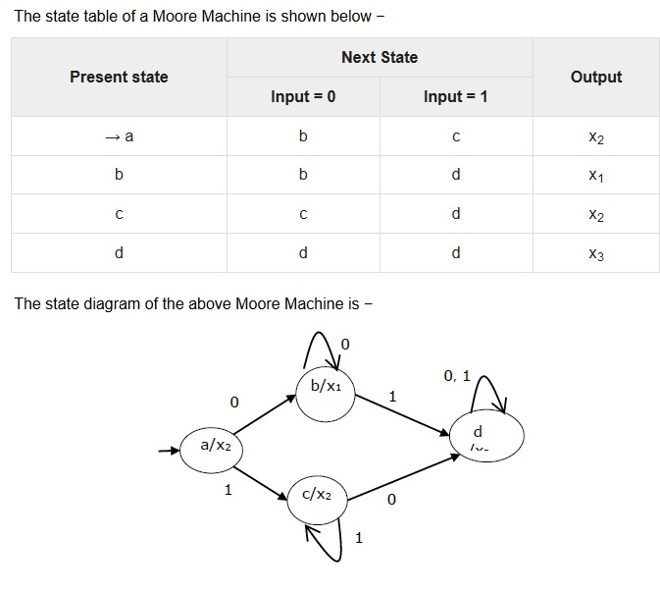
Example

Slide 51
Practice Questions
1. Construct Moore m/c that produce 1’s complement of any binary i/p string.
2. Design a moore m/c for a binary i/p sequence such that if it has a substring 101, the m/c o/p is A, if the i/p has substring 110, its o/p is B, otherwise o/p is C.

Slide 52
3. Design moore m/c, where i/p alphabet is ∑={a,b}, and the o/p alphabet is O={0,1}. Run the following i/p sequence and find the respective o/p:
aabab (ii) abbb (iii) ababb
State transition table is given as:
States | a | b | o/p
Q0 | Q1 | Q2 | 0
Q1 | Q2 | Q3 | 0
Q2 | Q3 | Q4 | 1
Q3 | Q4 | Q4 | 0
Q4 | Q0 | Q0 | 0

Slide 53
Conversion from Mealy machine to Moore Machine
In Moore machine, the output is associated with every state, and in Mealy machine, the output is given along the edge with input symbol.
To convert Moore machine to Mealy machine, state output symbols are distributed to input symbol paths.
But while converting the Mealy machine to Moore machine, we will create a separate state for every new output symbol and according to incoming and outgoing edges are distributed.

Slide 54
Step 1: For each state(Qi), calculate the number of different outputs that are available in the transition table of the Mealy machine.
Step 2: Copy state Qi, if all the outputs of Qi are the same. Break qi into n states as Qin, if it has n distinct outputs where n = 0, 1, 2....
Step 3: If the output of initial state is 0, insert a new initial state at the starting which gives 1 output.

Slide 55
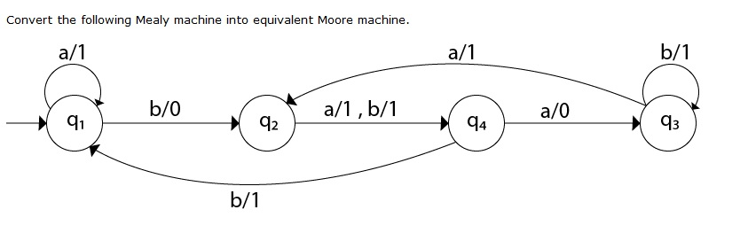
Practice Questions
Que:1

Slide 56
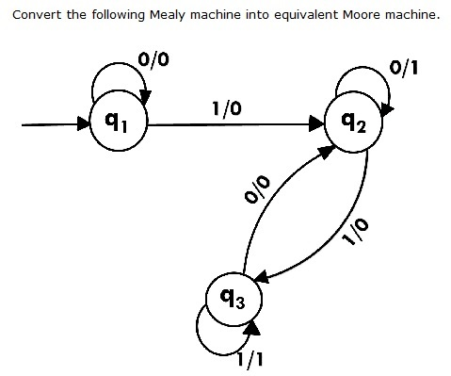
Ques:2

Slide 57
Conversion from Moore machine to Mealy Machine
We cannot directly convert Moore machine to its equivalent Mealy machine because the length of the Moore machine is one longer than the Mealy machine for the given input.
To convert Moore machine to Mealy machine, state output symbols are distributed into input symbol paths.

Slide 58
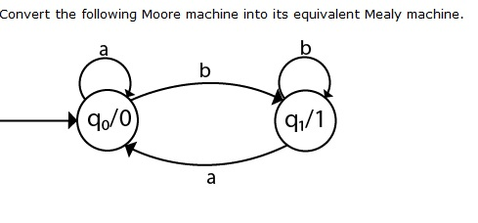
Practice Questions
Ques:1

Slide 59
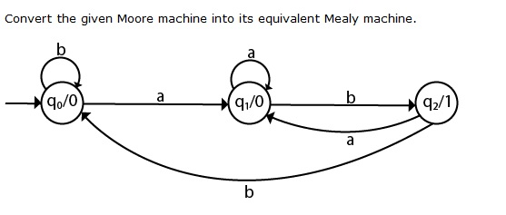
Ques:2

Slide 60
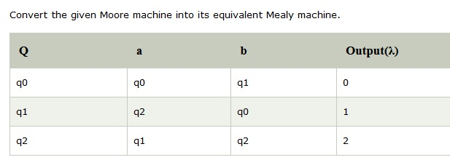
Ques:3

Slide 61
Ques:4 The moore m/c counts the occurrences of sequence ‘abb’ in any i/p binary strings over {a,b}. Convert it into its equivalent mealy m/c.

Slide 62
Minimization of DFA
Equivalence Theorem
Minimization of DFA means reducing the number of states from given FA.
Step 1: Remove all the states that are unreachable from the initial state via any set of the transition of DFA.
Step 2: Draw the transition table for all pair of states.
Step 3: Now split the transition table into two tables T1 and T2. T1 contains all final states, and T2 contains non-final states.

Slide 63
Step 4: Find similar rows from T1 such that:
1. δ (q, a) = p
2. δ (r, a) = p
That means, find the two states which have the same value of a and b and remove one of them.
Step 5: Repeat step 3 until we find no similar rows available in the transition table T1.
Step 6: Repeat step 3 and step 4 for table T2 also.
Step 7: Now combine the reduced T1 and T2 tables. The combined transition table is the transition table of minimized DFA.

Slide 64
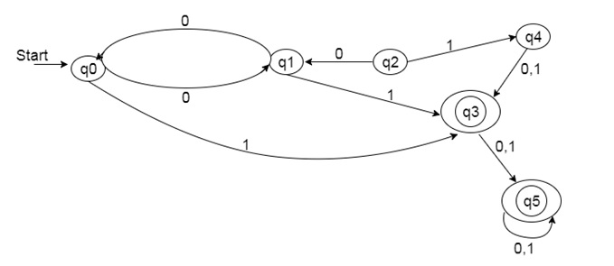
Practice Questions
Ques:1 Minimize the given DFA:

Slide 65
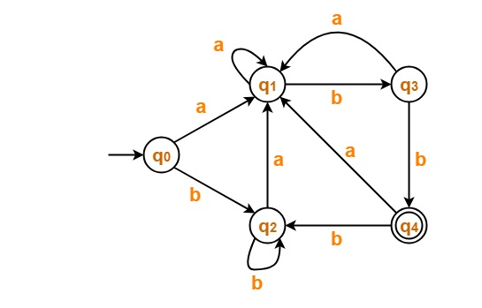
Ques:2 Minimize the given DFA:

Slide 66
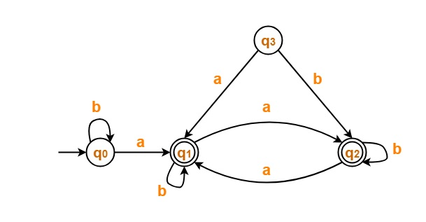
Ques:3 Minimize the given DFA:

Slide 67
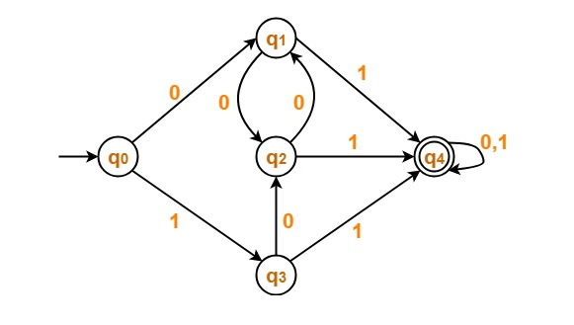
Ques:4 Minimize the given DFA:

Slide 68
Minimization of DFA
Table Filling Method
(MyHill Nerode Theorem)
Suppose there is a DFA D < Q, Σ, q0, δ, F > which recognizes a language L. Then the minimized DFA D < Q’, Σ, q0, δ’, F’ > can be constructed for language L as:
Step 1: We will divide Q (set of states) into two sets. One set will contain all final states and other set will contain non-final states. This partition is called P₀.
Step 2: Initialize k = 1

Slide 69
Step 3: Find P_{k} by partitioning the different sets of P_{k-1}. In each set of P_{k-1}, we will take all possible pair of states. If two states of a set are distinguishable, we will split the sets into different sets in P_{k}.
Step 4: Stop when P_{k} = P_{k-1} (No change in partition)
Step 5: All states of one set are merged into one. No. of states in minimized DFA will be equal to no. of sets in P_{k}.

Slide 70
How to find whether two states in partition P_{k} are distinguishable ?
Two states ( qi, qj ) are distinguishable in partition P_{k} if for any input symbol a, δ ( qi, a ) and δ ( qj, a ) are in different sets in partition P_{k-1}.

Slide 71
POLLING QUESTIONS
Number of states require to accept string ends with 10.
A) 3
B) 2
C) 1
D) can’t be represented.
Notes:
a

